Slide 1
Strategic Investing for Growth
& Innovation
Amy Raimundo, Kaiser Permanente Ventures
May 20, 2026
Confidential: Do Not Distribute

Slide 2
Topics
KP Ventures - Structure and History
Strategic Investing - Value and Purpose
KP Investing: Approach and Themes
Lessons Learned
What’s Next

Slide 3

KP Ventures | Bio
Amy Belt Raimundo, VP and Managing Director of Kaiser Permanente Ventures
Background
Venture Capital —19 years health tech, medtech, dx, services
Company Operations — 7 years
medtech and health tech
Strategic Consulting– 5 years
health systems
Yale University– BA Economics
University of California, Berkeley – MBA
Kauffman Venture Fellow
3

Slide 4
KP Ventures | Fund Profile
KP Ventures is one of the longest tenured strategic venture capital programs in healthcare.
Venture Fund Profile
Founded in 1997—28-year history, early corporate fund
6 Funds Raised—Four are currently active
$663M Assets under Management—$758M raised to date
80+ Companies Backed – 24 in active portfolio
Unique Fund Structure – Mix of internal and external LPs
4

Slide 5
KP Ventures | History
KP Ventures is managing four active funds which are in different stages of the fund lifecycle. KPV VI was been launched and the first investment was made in January 2025.
1995
2000
2005
2010
2015
2020
2025
Active Funds
Pre-Fund I
KPV I
KPV II
KPV III
KPV IV
KPV V
KPV VI
$4M
Initiated 1997
$24M
Initiated 2000
$67M
Initiated 2004
$159M
Initiated 2008
$143M
Initiated 2015
$141M
Initiated 2019
$220M
Initiated 2024
$24M
$4M
$67M
$159M
$143M
$141M
$220M
5
Returns are provided as of year-end, December 2023

Slide 6
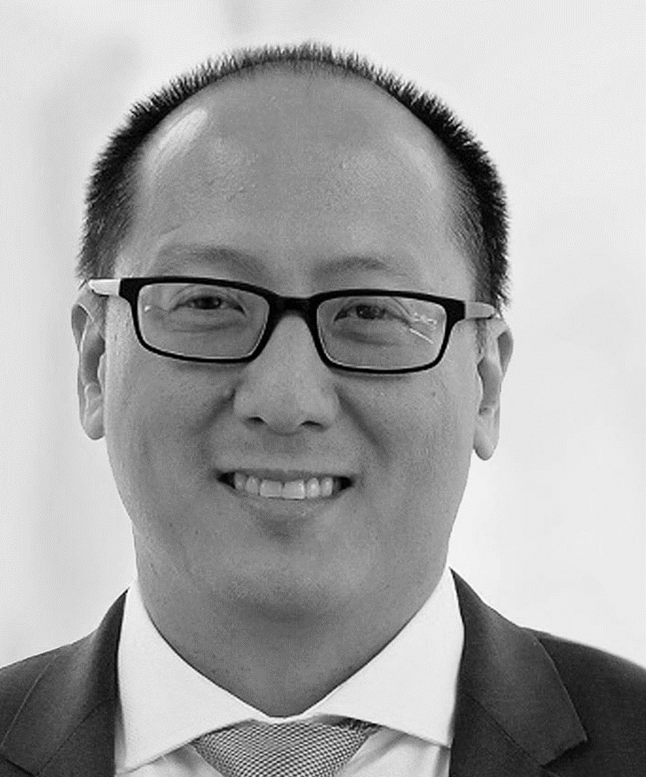

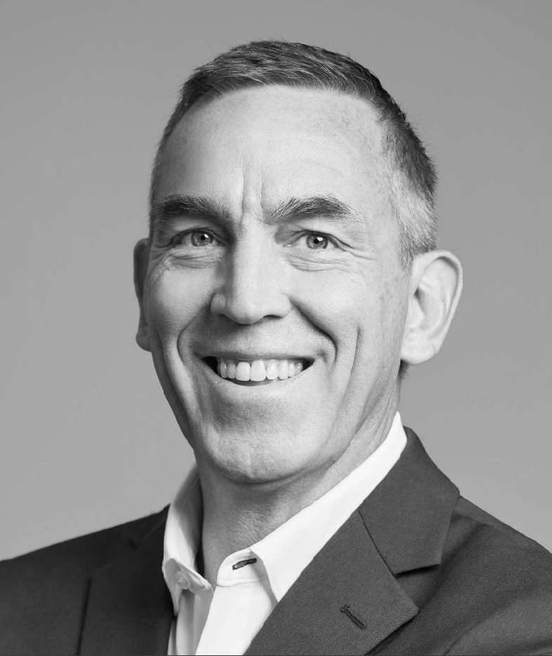
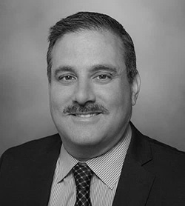



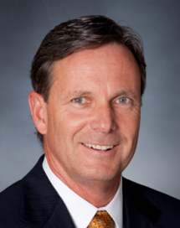
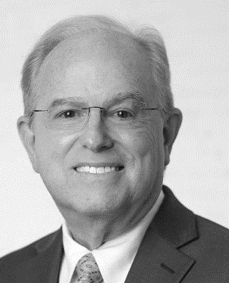

KP Ventures| Investment Committee
Executives from across Kaiser Permanente work collaboratively on the Venture Fund Management Committee (VFMC) to provide both governance and insight to the work of KP Ventures.
Nolan Chang, MD
Executive Vice President
The Permanente Federation
Regional Medical Director
Southern California Permanente Medical Group
Mary Chasko, MD
Chief Information Officer
Mid-Atlantic Permanente Medical Group
Neil Cowels
Senior Vice President, Chief Technology Officer
Kaiser Foundation Hospitals and Health Plan, Inc.
Chris Grant
Executive Vice President and Chief Operating Officer
The Permanente Federation
Kevin Hart
SVP, Strategic Development &Technology, N. California
Kaiser Foundation Hospitals and Health Plan, Inc.
Sande Irwin, MD
National Product Counsel, Chair & Physician
Northwest Permanente Medical Group
Stephanie Ledesma
Senior Vice President, National Health Plan Enablement & Integration
Kaiser Foundation Hospitals and Health Plan, Inc.
Thomas Meier
Senior Vice President and Treasurer
Kaiser Foundation Hospitals and Health Plan, Inc.
Paul Minardi, MD
Executive Vice President & CEO
KP Medical Foundation
Ken Trauner, MD
TPMG Innovation Lead & Orthopedic Surgeon
The Permanente Medical Group
6

Slide 7
Strategic Investing | Purpose
Many corporate venture funds define themselves along the strategic to financial continuum. KP Ventures seeks to invest in the overlap between strategic and financial.
Strategic
Financial
Monitor market disruptions
Inform strategy from emerging technology and models
Identify companies that can accelerate capabilities & growth
Multiply the money
Diversify sources of return
Leverage insights and assets to generate returns
7

Slide 8
Strategic Investing | Strategic Value
KP Ventures has the opportunity to enhance the bidirectional exchange between KP and innovation/venture capital world.
Align Strategic Interest
Sense Market Disruptions
Deepen Key Relationships
Influence Market Changes
Invest As Need is
Emerging
Invest Alongside
KP Relationships
Invest to Drive the Market
Advance team for market disruptions and innovation opportunities
Explore new models to inform future strategy and approaches
Evolve vendor relationship into strategic partnership where appropriate
Enhance communication to advance the goals of both organizations
Leverage expertise and assets to drive the innovations we need
Influence and accelerate the innovation we want to see
8
8

Slide 9
KP Investing | Approach
KP has 2 separate approaches to venture investing. KP Ventures has had a consistent investment approach over six funds. The strategic investments are more varied and recent.
KP Ventures
Strategic Investments
Structure: Traditional fund structure
Amount: $15-20M per investment
Stage: Series A to Growth
Rights: Minority ownership, board director/observer, information rights
Relationship: KP relationship not required nor guaranteed
Portfolio Size: 24 companies
Structure: Balance sheet
Amount: $20-200M per investment
Stage: Seed to Growth
Rights: Minority, majority and JV, board director/observer, information rights
Relationship: KP operational need, significant operational integration
Portfolio Size: 4
9

Slide 10



KP Investing | Investment Themes
KP Ventures has identified 9 key areas we are targeting proactively based on our understanding of KP priorities and the venture capital activity.
Pharmacy
Workforce
Health Equity
Administrative Simplicity
Demand Planning & Scheduling
Clinical Decision Support
High-cost Drug Management
Predictive Analytics
Medication Optimization
Access and Affordability
Rural Care
Disparities in Care
Operational Optimization
Patient Experience
Home
Patient Navigation
Virtual Specialty Care
Patient Facing AI
Last Mile Logistics
Home Diagnostics
Transitions of Care
Back-Office Efficiency
Data Analytics Infrastructure
Smart Hospital
High Resource Conditions
Government LOB
InsurTech
Complex Care Management
Member Engagement & Activation
Documentation & Reporting
Kidney Disease
Oncology
MSK
Mental Health
Revenue Cycle & Payment Integrity
Member Attraction & Retention
Value-based Care Enablement
10
Notes:
Top line: changes to the 9 boxes > hand off to each associate to talk through each of the 3/9 subtheme boxes (high level); slide 10 as the talk track (unmet need and market activity are the WHY) and an example of one company in each space to highlight (Why, What, Who)

Slide 11


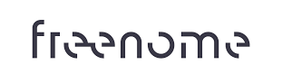


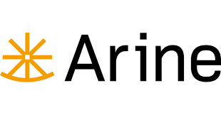

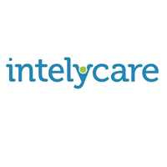


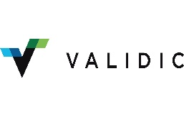
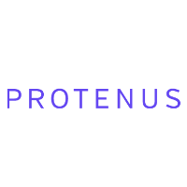

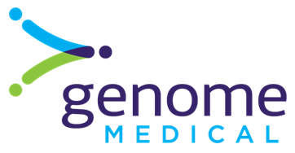


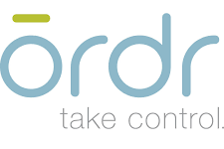






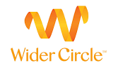


KP Investing | Portfolio Companies
Investments are targeted to areas of high strategic priority for KP. Two-thirds of our portfolio have commercial relationships with KP. Companies must earn the relationship with KP.
Pharmacy
Workforce
Health Equity
*
*
Operational Optimization
Patient Experience
Home
*
*
**
**
High Resource Conditions
Government LOB
InsurTech
**
**
11
* Recently exited investments
** Strategic investments
Notes:
Top line: changes to the 9 boxes > hand off to each associate to talk through each of the 3/9 subtheme boxes (high level); slide 10 as the talk track (unmet need and market activity are the WHY) and an example of one company in each space to highlight (Why, What, Who)

Slide 12
Strategic Investing | Lessons Learned
#1 Making the investment is only 10% of the work
Start-ups run out of money every 18-24 months BY DESIGN
The venture capital market changes a lot over the investment
Staying active with the company is necessary to generate and protect value
Being the translator between what the needs of the company and the strategic requires sophistication about both sides

Slide 13
Strategic Investing | Lessons Learned
#2 Reserve, reserve, reserve
You will lose money if you come in and out of investments
Companies take 5-15 years to exit and raise multiple times
A company is only as good as the funding market they are in
If you don’t have money to invest, a down round can wipe you out

Slide 14
Strategic Investing | Lessons Learned
#3 Don’t invest with just fellow strategics
Strategics add a lot of value, but institutional investors are paid solely to multiply the money
Paying attention to the changing financial metrics and fundraising requirements is critical
Companies often need a hard reset or major reductions in burn
Partners who anticipate these drive complementary value

Slide 15
Strategic Investing | Lessons Learned
#4 Avoid “snowflake” investments
Venture investments only succeed if they achieve rapid growth
The solution must be attractive to a large market
The more of a “snowflake” your organization, the less representative
Be sure that more than just your organization needs the solution

Slide 16
Strategic Investing | Lessons Learned
#5 Create an efficient decision-making process
Most funds are created because “one-off” investment decisions are too slow and too resource intense
Create a clear, consistent and timely process and expectations
Have standard diligence and analyses templates
Involve decision-makers who can best inform the strategic value

Slide 17
Strategic Investing | Lessons Learned
#6 Be clear about your “must solve” issues
Tell them to your venture team, don’t make them guess
Bottoms-up prioritization can waste a lot of time and resources
Venture is best for priorities that aren’t solved and aren’t going away
Disruptive solutions can change the dynamics in unexpected ways

Slide 18
Strategic Investing | Lessons Learned
#7 Structure in an executive feedback loop
Both strategic and financial results are enhanced
Venture curates lists of companies and learnings from diligence
In return, executives refine the venture’s understanding of the need
Then Venture can better target and surface solutions and insights

Slide 19
Strategic Investing | Lessons Learned
#8 Start-ups are the vendor of last resort
Start-ups are fragile, hard to scale and difficult to work with
Being better is not enough; incumbents must not be good enough
“Not good enough” could be quality, speed, capability or total cost
If you need a start-up, don’t kill it on price or customization

Slide 20
Strategic Investing | Lessons Learned
#9 It’s harder than it looks
There is a lot of competition for good deals
A lot of capital is chasing these deals which drives up valuations
Returns suffer with higher valuations or lots of lookalike companies
Leverage unique insights, assets and profile to get in the good deals

Slide 21
Strategic Investing | Lessons Learned
#10 Layer your relationship to create more value
You can create value by partnering in multiple ways
Equity investment is only one facet to generating value
“Sweat equity” for co-development generate returns without cash
Early adopters or scaling partners can drive attractive contracts
You don’t need to pick just one approach

Slide 22
Strategic Investing | AI Lessons Learned
What we’ve learned from investing in AI so far…
Companies must leverage the open models and they can’t just leverage the open models
The improvement cycles are incredibly quick and capability is commoditized rapidly
The basis of competitive advantage has shifted from technology development to distribution, capital and speed.
Companies must have a large surface area to expand into to prevent competition from catching you
Valuations are incredibly high because large funds don’t want to miss the next big one
Team is even more important because the world is changing so fast

Slide 23
Moving Forward| Last Year
AI Revolution: Miracle or commodity? Both? Who wins? Who loses? Who do we partner with?
Data Integration: Will we finally get something meaningful from all this data? Will bringing it together and into the workflow do it?
Workforce Augmentation: Will technology stop being the problem and start being the solution?
Platforms: Point solutions are consolidating or new solutions expanding right and left. Who has the right to win? To expand?

Slide 24
Moving Forward| Now
AI Agents: AI taking-action in the workflow.
  Who is best positioned to create, monitor and managed?
Patient Facing AI: AI to close the gap on access and patient experience.
  What are the right guardrails and systems?
Physical AI: AI interacting with the physical world.
  How to integrate video, robotics to bring AI into physical spaces?

