Slide 1
Results and Lessons Learned From a Systematic Approach to Becoming a High Reliability Organization
Daniel Varga, MD, SEVP & Chief Clinical Officer
Texas Health Resources
The Leadership Institute | May 17, 2018

Slide 2
Objectives
Overview of Texas Health
Describe the Texas Health HRO Journey roadmap
Review HRO principles and error-prevention tools in the Texas Health toolkit
Introduce tactics used to reinforce HRO principles and use error-prevention tools
Discuss reporting and governance evolution and its impact on HRO
Explore implications of industry transformation on HRO journey

Slide 3
Our Mission and Values
Our Mission
To improve the health of the people in the communities we serve
Our Values
Respect, Integrity, Compassion and Excellence
Our Vision
Partnering with you for a lifetime of health and well-being
Notes:
In describing who we are, we like to start with our guiding principles — our Mission, Vision and Values.
Our Mission, Vision and Values are essential pieces of our identity.
Our Mission describes why we exist. We look on each one of the 7 million North Texans as someone’s family member.
We have many points of access, many types and providers of care, but we one system with one mission.
Our Values summarize how we act, toward our patients, visitors and each other.

Slide 4
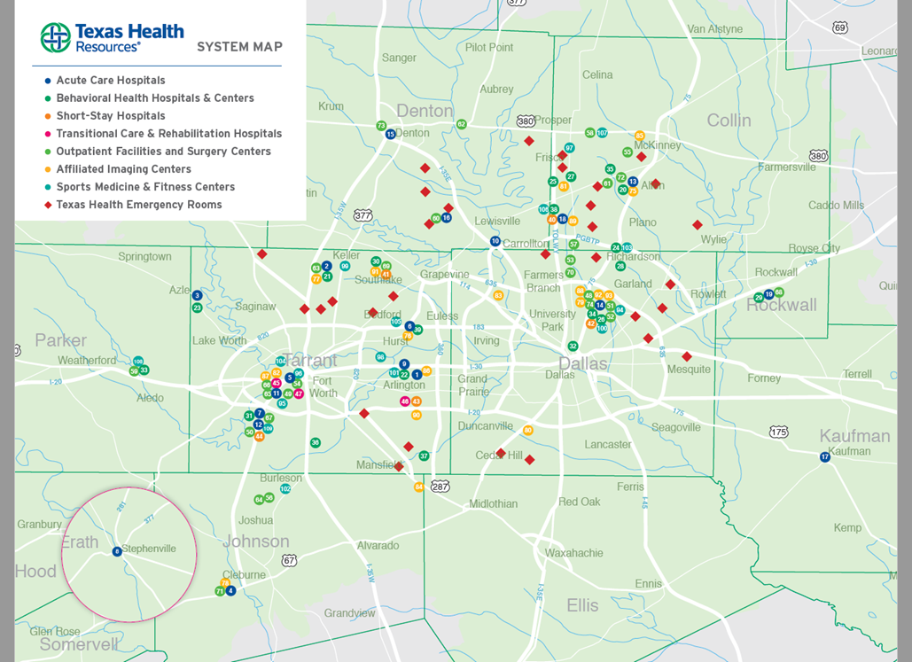
Texas Health: Who We Are
One of the largest faith-based, nonprofit health care delivery systems in the U. S.
Primary service area: 16 counties in North Texas, home to more than 7 million people
More than 24,000 employees of wholly owned/operated facilities, plus 2,200 employees of consolidated joint ventures
  7,800 nurses on staff
  6,000 physicians with active staff privileges
  Texas Health Physicians Group: 600 physicians, 350 physician assistants and nurse practitioners
Notes:
Our Mission, Vision and Values shape us as on the nation’s largest faith-based, nonprofit health care systems.
We’re privileged to serve one of the nation’s fastest growing regions. The population of North Texas is expected to top 10 million by 2020.

Slide 5
Texas Health: Who We Are
More than 350 points of access in North Texas
29 hospital locations — acute-care, short-stay, behavioral health, rehabilitation and transition care facilities — owned, operated or joint-ventured
100 outpatient facilities, satellite emergency rooms, surgery centers, behavioral health facilities, fitness centers and imaging centers
250 other community access points
3,900 licensed hospital beds
(3,300 operated/available beds)
Notes:
We started as an excellent acute-care hospital system when we brought the Harris Methodist and Presbyterian health systems together with Arlington Memorial Hospital in 1997.
From 2007 through 2016 we completed a strategic plan in a process we called “Climbing Transformation Mountain.” During this time we evolved into a nationally benchmarked health care delivery system.
Today Texas Health comprises 29 hospital locations and more than 350 ambulatory access points across North Texas.

Slide 6
Texas Health: Who We Are
700,000 annual emergency visits
25,000 annual deliveries
1.7 million inpatient and outpatient visits
Provided $863.9 million in Community Benefit and Charity Care in 2016
$4.52 billion in total operating revenue
(FY 2016)
$7.98 billion in total assets (FY 2016)
Notes:
A few numbers help to tell the story of our impact on health care delivery in North Texas.
The volume stats are important primarily because they show people are choosing Texas Health for their health care.
We believe strongly in giving back to the community. Our charity care and community benefit exceeds our Texas nonprofit requirement by almost 22 percent. We believe it’s the right thing to do.
And our strong financial position helps ensure that we can sustain our mission.

Slide 7
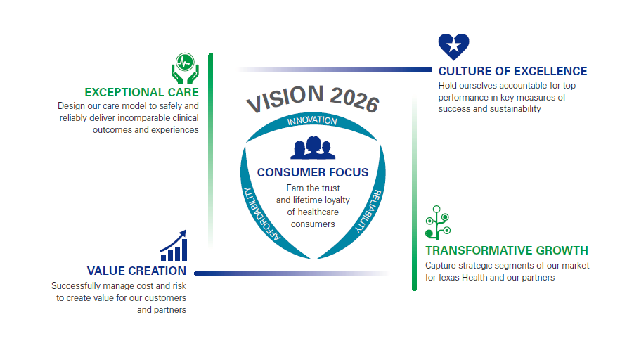
Notes:
Our vision of partnering with consumers for a lifetime informs our strategic direction.
As we designed our next 10-year strategy, Vision 2026, we were guided by the principle that we must earn the trust and lifetime loyalty of health care consumers.
All of Texas Health’s work for the next 10 years will center on five themes:
Consumer Focus
Exceptional Care
Culture of Excellence
Transformative Growth
Value Creation
The themes are interconnected:
Consumer Focus will always be in the center because consumer decision-making touches every other aspect of what we do. From that starting point:
Exceptional Care opens the door to greater value being delivered on experience, cost and outcomes.
Culture of Excellence builds a foundation, expectation of excellence in all our venues that will enable exceptional care.
Transformational Growth ensures we have the assets, products, venues and services that can deliver both Exceptional Care and Value Creation.
Ultimately, around it all will be the needs, wants and desires of the consumer, who will be demanding more from us.

Slide 8
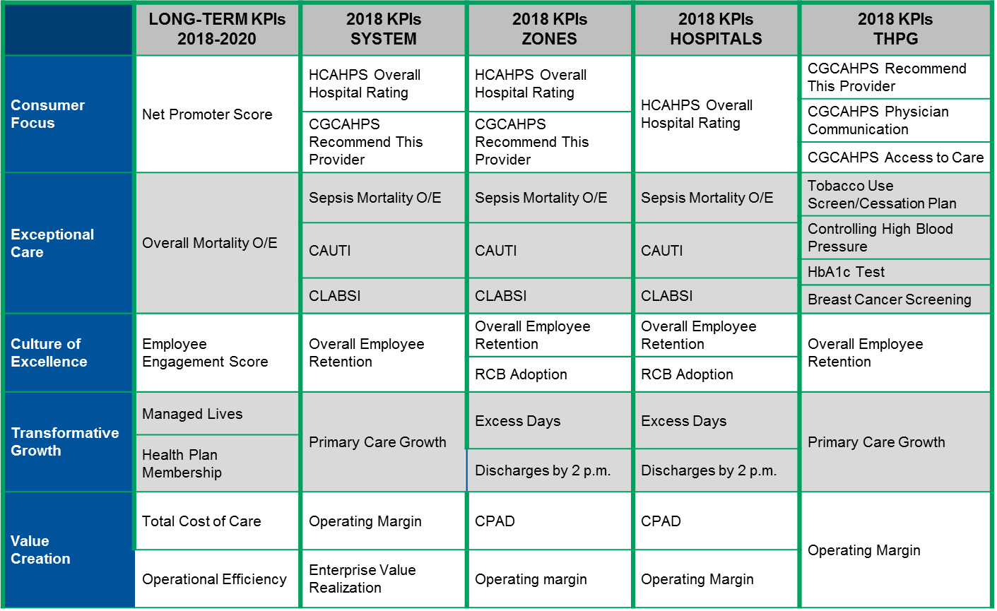
2018 KPIs: Overview

Slide 9
Texas Health Journey to High Reliability
Leader Training: Making Reliability a Reality: Leadership Methods for High Reliability
Module 1: High Reliability Principles and Core Leader Strategies
Module 2: Building and Reinforcing Accountability
Module 3: Safety Strategies and Error Prevention Tools
Implementation Reliability Learning Tool (RLt)
Training of all staff and Leadership based on role
Execution of Performance Management Guide
6 Step Safety Event Review Process
Promise Training and Leadership Behaviors
Implementation RISI Tool
Departmental Safety Briefing
Design and Implement Problem List
Engage Medical Staff
Leadership Training
RISI Tool/ Dept. Safety Briefing
Reliability Learning tool
2014
2015
2016
2017
2017
2018+
HPI assessment
Staff Training
Sustainment/ Reliability Coaching
  Trained 22,000+ Employees
EPT Reliability Lab Part 1: “I Make Reliability A Reality”
EPT Lab Part 2: “I Make Reliability A Reality”
Physician Training with CME: Texas Health EPT Reliability Lab
  2800 physicians trained (rate continues to increase with ongoing training)
Culpability Evaluation Tool Evaluation (Safe Choices vs. PMDG)
2016 KPI: High Reliability Training
3 Part Diagnostic Assessment
  Common Cause Analysis
  Safety Governance Assessment
  Safety Culture Survey
Establish SSER and harm classification of events
AHRQ Survey on Patient Safety
Reliability Coach Training: Reliability Coach Skill Building- “Coaching to Zero”
HRO Game Day Video
Cause Analysis Training

Slide 10
Error Prevention Tools
Every Texas Health employee is expected to learn and use individual reliability skills – Error Prevention Tools
  ALL receive training
  ALL expected to make habit
Leaders’ role is to:
  Role model tools
  Resolve obstacles to tool use
  Reinforce and build accountability around expectations

Slide 11
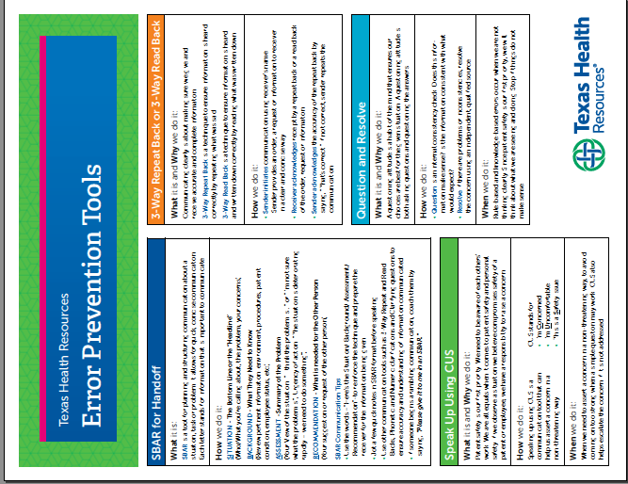
STAR
3-Way Repeat Back and 3-Way Read Back
Ask Clarifying Questions
Phonetic and Numeric Clarification
SBAR
Question and Resolve
Escalate Using CUS
Cross Check for Accountability
5:1 Feedback

Slide 12
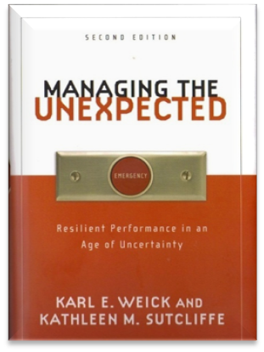
Five Principles of HROs
Preoccupation with Failure
We pay attention to precursor or near miss events as a symptom something’s wrong
We proactively identify activities we do not want to go wrong
We discuss what to look out for when giving report to an oncoming shift
We engage in proactive and preemptive analysis and discussion
Sensitivity to Operations
Paying attention to what’s happening on the front-line
Reluctance to Simplify interpretations
Take deliberate steps to question assumptions and seek wisdom to create a more complete and nuanced picture of ongoing operations
Commitment to Resilience
The capability to detect, contain, and bounce back from events before they worsen and cause more serious harm
Deference to Expertise
When necessary decision-making authority migrates to the person with the most expertise with the problem at hand, regardless of rank
Notes:
CREATE Texas Health EXAMPLES
FAILURE- OPERATIONS- LEADERSHIP ROUNDING/ SAFETY BRIEFINGS / ROUNDING
SIMPLIFY/ RESILIENCE- IV PUMP- THD, uncovered bigger problem than one case at THD (didn’t simply problem) + put in place strategy to handle bigger problem (aging pumps throughout system)
EXPERTISE- MOCK EMERGENCY MANAGEMENT TEST AND GENERATOR GOING DOWN (REAL EVENT) SIMULTANEOUSLY
CLICK x5
Karl Weick & Kathleen Sutcliffe are the authors of Managing the Unexpected, a book which describes the principles by which HROs function. Weick and Sutcliffe talk about five areas of focus – The first three are Principles of Anticipation (how we can stay out of trouble) and the last two are Principles of Containment (how we limit or contain the extent of harm when things don’t go well)
The first element – Preoccupation with Failure – is critical to becoming an HRO. In HRO’s leaders are fanatically preoccupied with failure – they are always looking for seemingly small errors and problems as indications something bigger is lurking around the corner.
In HROs, Leaders are always paying attention to what’s happening on the front line
HROs regard close calls and near misses as a kind of failure that reveals potential danger rather than as evidence of our success and ability to avoid disaster.
When an unexpected outcome occurs, HROs have a strong ability to detect, correct and bounce back before situations worsen
And, finally, HROs know that, when necessary, especially in emergency situations, decision-making authority goes to the person with the most expertise with the problem, regardless of rank.

Slide 13
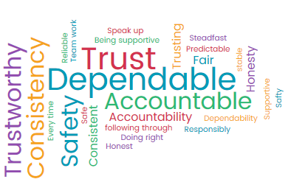
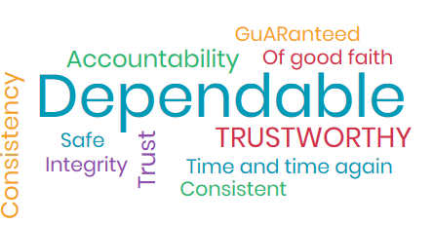
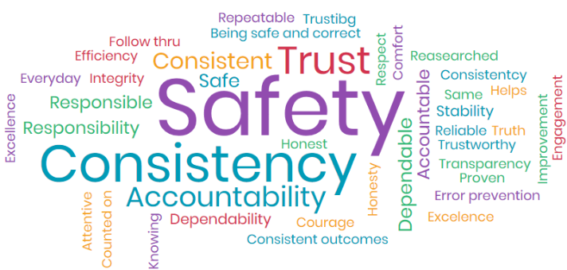
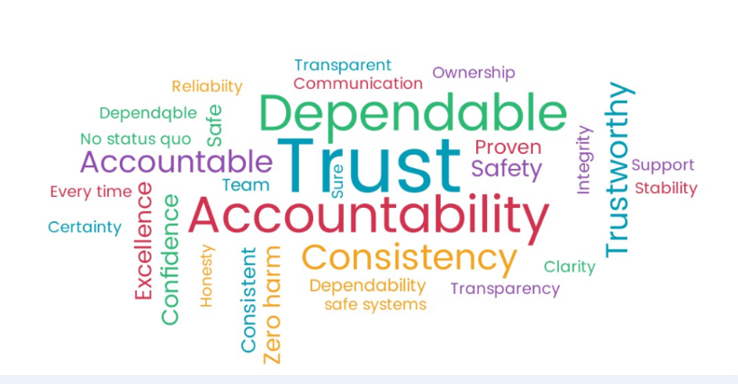
High Reliability at Texas Health
Critical Success Factors
Reliable Care Blueprinting
Patient Safety Event Reporting
Cause Analysis Redesign
Habit Formation through Reliability Coaching
Promise Training/Leadership Behaviors
Notes:
Tiles at the right are key words related to “what reliability means to me” as collected during our reliability coach training.
Safety Culture
HRO Leadership and staff development
Game Day Interprofessional Learning Video
New Leader Orientation
Leapfrog
AHRQ Culture of Safety Survey
Launched Reliability Coaching Program in July, 2017
THR System HRO Sustainment and Implementation Team
Patient Safety Measurement
SSER Improvement
Implemented new Safety Event Reporting Tool January 2017
Harm Classification
Safety MVP Program
Cause Analysis Redesign
RISI Implementation (Reliability Implementation and Sustainment Index)

Slide 14
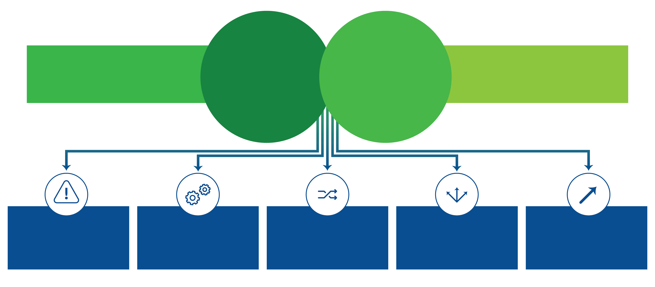
RCB designs and deploys the processes required to support our journey towards high reliability
Design and implement processes to reliably deliver outcomes-driven care
Build a culture of safety and reliability
High Reliability
Organization
Reliable Care
Blueprinting
IDENTIFY CRITICAL
STEPS
ENGINEER THE
PROCESS
HARDWIRE CARE ENVIRONMENT WORKFLOWS
DEPLOY NEW PROCESS TO CARE
AT THE BEDSIDE
SUSTAIN AND IMPROVE DESIGN

Slide 15

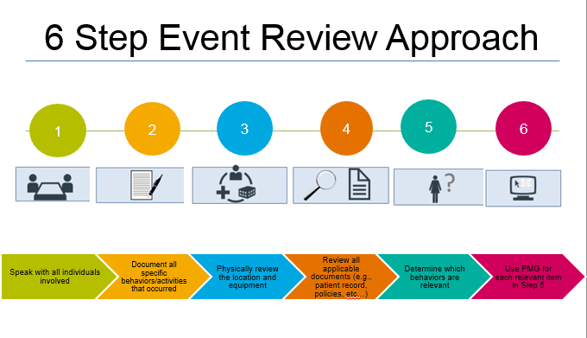
Patient Safety Event Reporting:
Being Reliably Obsessed with Outcomes
Texas Health has a goal of getting to Zero Harm for our patients. We believe that most events are preventable. In order to address Unexpected Bad Outcomes for patients in which, according to the SEC algorithm, no deviation from GAPS has occurred, we need to build a process to capture and review learnings.
Event Reporting Taskforce Solution:
  Build question into Closer Review section of RL, “Was the outcome for this patient Expected?” If answer is No, then it will be captured in the RL database so we can analyze in order to prevent it from ever happening again.
Texas Health’s Reliability Learning tool
Notes:
Reliability Learning tool
Safety Event Classification improvement (Finalize IRR Results & Add Known Complications Test in RL)
Develop Safety Event Analysis and Reporting Plan (current Event Reporting Taskforce subgroup)
Identifying harm that was “preventable”
Improve Capture of all Safety Events in Reporting tool
Preventable Mortalities (beyond Sepsis and H&V)
HAI’s, PSI’s, & HACs (reported to CMS & some to state)
Preventable Adverse Events (PAEs reported to State)
Get to Reliable Baseline SSER in 2017
Ensure clarity around THR operational definition for an SSER and SSE including:
Capture all available data sources (SALT, RL, administrative billing data, HAI Surveillance data, mortality reviews, etc)
Continue Improvement work!

Slide 16
Continued focus to increase reporting of events at all levels for the goal of increase system learning.
Notes:
Continued focus to increase reporting of events at all levels for the goal of increase system learning.

Slide 17
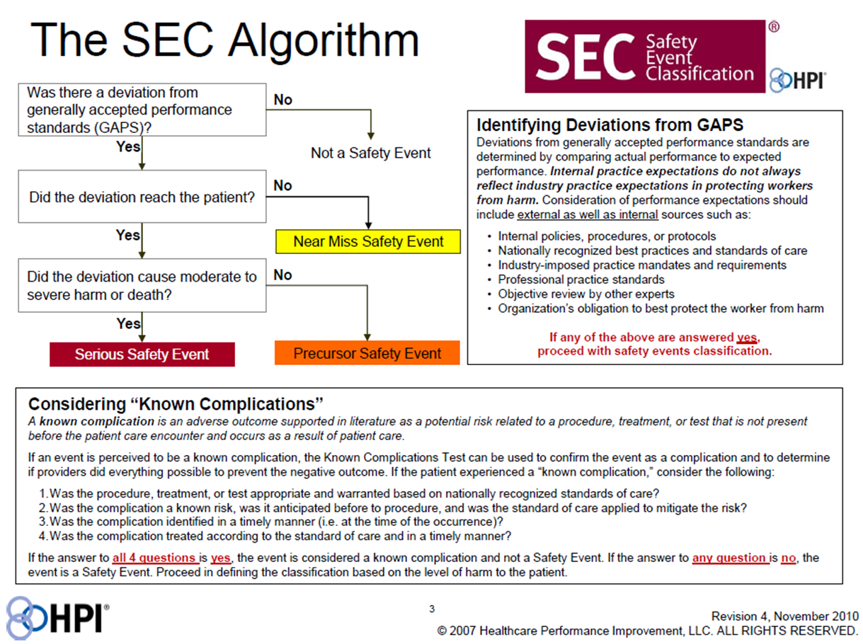
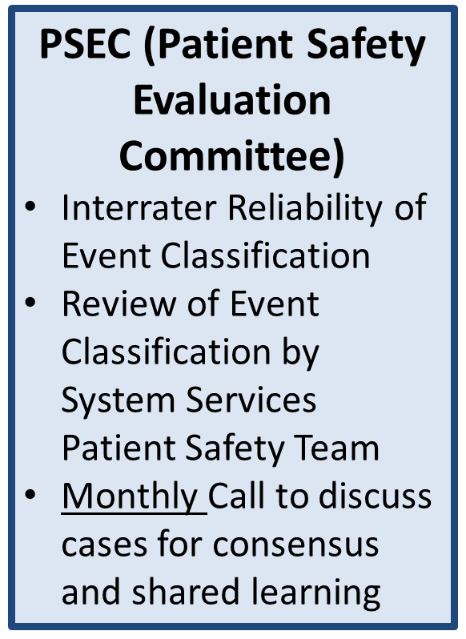
Improving Patient Safety Event Classification for consistency
& learning
Notes:
Finding Deviations
Focus on term “deviation” – review examples listed on slide. (avoid misuse of GAPS which = Generally Accepted Performance Standards)
Functions of the Safety Event Classification Team
Goals
Consistent, core group making up a Patient Safety Event Classification (PSEC) Committee
Do you have enough information to classify the event before the cause analysis is complete? We can always go back and change it
Err on the side of the higher classification
Pull in stakeholders, subject matter experts such as ED Medical Director, Department Chair
Conduct the Known Complications Test Four Questions:
1) Was the procedure, treatment, or test appropriate and warranted
based on nationally recognized standards of care?
2 ) Was the complication a known risk, was it anticipated, and did the
care team plan ahead to take steps to prevent it?
3) Was the complication identified in a timely manner (i.e. at the time occurrence)?
4) Was the complication treated according to the standard of care and in a timely manner?
If the answer to ALL four questions is YES, the event is considered a known complication and NOT a Safety Event.
If the answer to ANY question is NO, a deviation in GAPS exists and the event is a Safety Event.
Classify near miss, precursor, and serious events
Attendees will stay abreast of all events that are entered in RLt

Slide 18
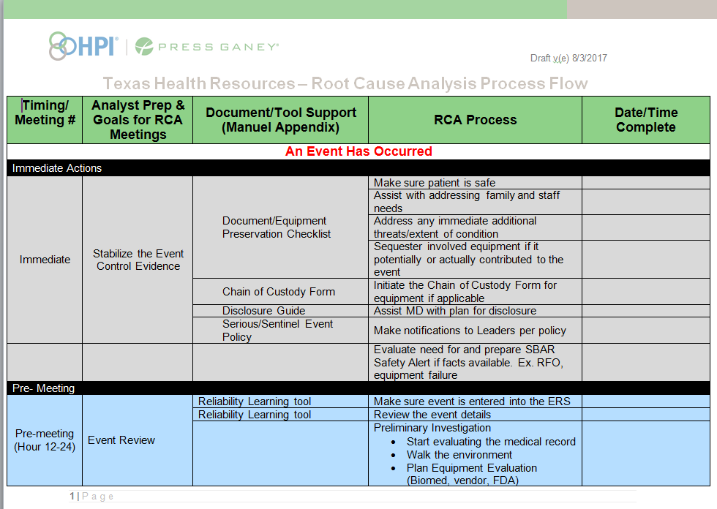
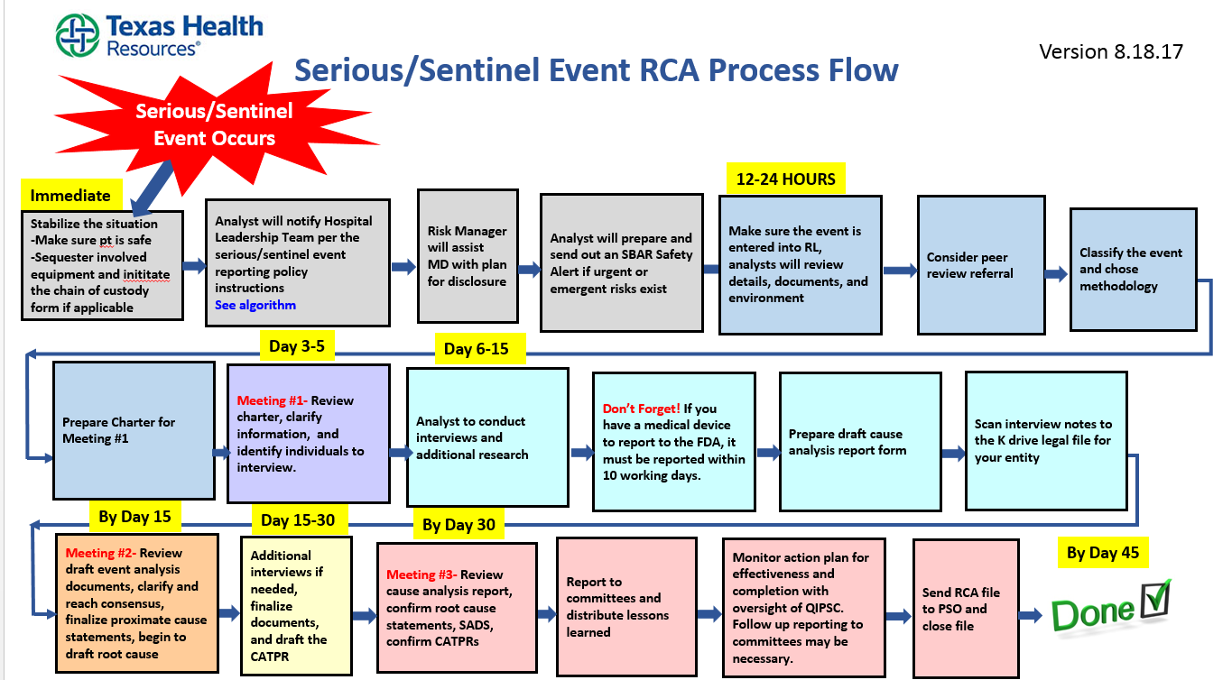
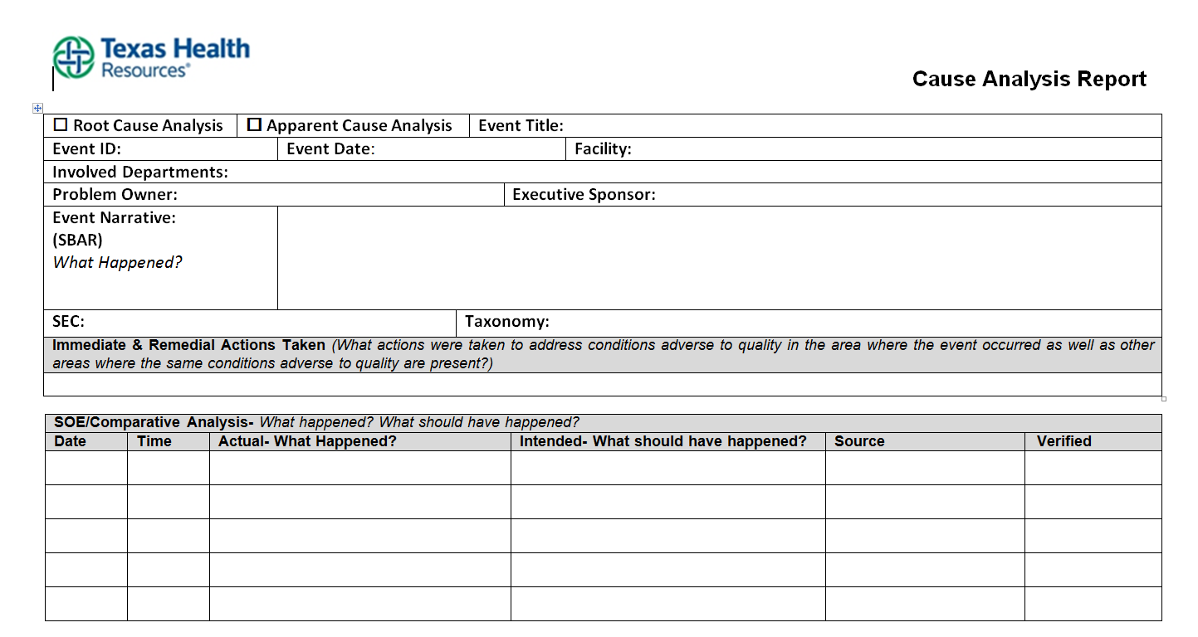
Cause Analysis Redesign: Training in November, 2017
Notes:
High Reliability leaders need to prevent (via reliable practice of error prevention techniques) and detect (via attention to issues on the front line, attention to emerging or continuing problems or other mechanisms that demonstrate operational situational awareness) problems that make it difficult for staff to practice correctly and reliability. These incorrect practices can lead to a safety event.
But just knowing what the problems are and fixing them isn’t enough – leaders must also look for the causes of the events. Just fixing the problem at the time it occurs, accomplishes only that outcome. But the problem can recur. Looking for the deeper causes and fixing those can reduce the chance that the event will happen again in the future.
Why perform cause analysis: as leaders, we have an imperative to prevent and detect problems that can lead to an event. Yet, we have a more profound obligation to correct causes once an event has occurred.

Slide 19




I Promise to Keep Me and You Safe
Promote Near Miss Reporting
Highlight the use of Error Prevention Tool(s)
Transportability- “It can happen to you”
Making Harm Visible at Texas Health
…and more importantly, our efforts to eliminate it!

Slide 20
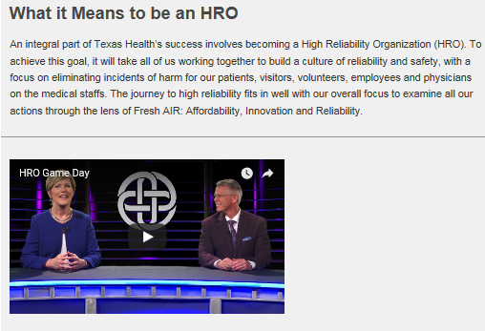
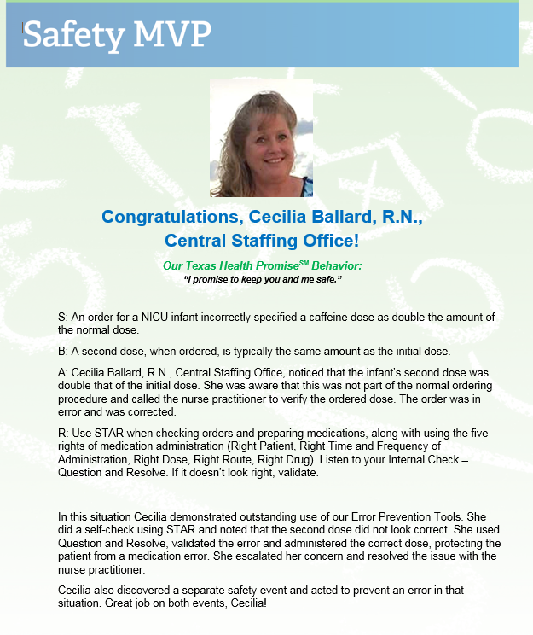

Making Harm Visible
Notes:
HRO Training: In 2015, training requirement of all leaders
In 2016, Trained >22,000+ THR staff and 1800 (2015 2016) of physicians in HRO principles and Error Prevention Tools
Game Day: Video developed with competency for physician training. The video is interprofessional and will be utilized in New Employee Orientation as well for training.
New Leader Orientation: Starting in October 2017, new leaders orientation will include 2 hours dedicated to HRO and taught by THR executive leaders.

Slide 21
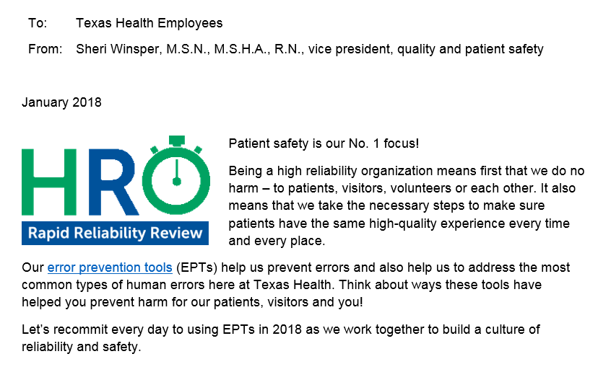
Notes:
Inform and continue education/ knowledge on HRO principles and initiatives.
Engage audience and keep HRO ‘fresh’ and top of mind. Tie in with other initiatives
CONSIDER PREVIEW OF STAR VIDEO

Slide 22
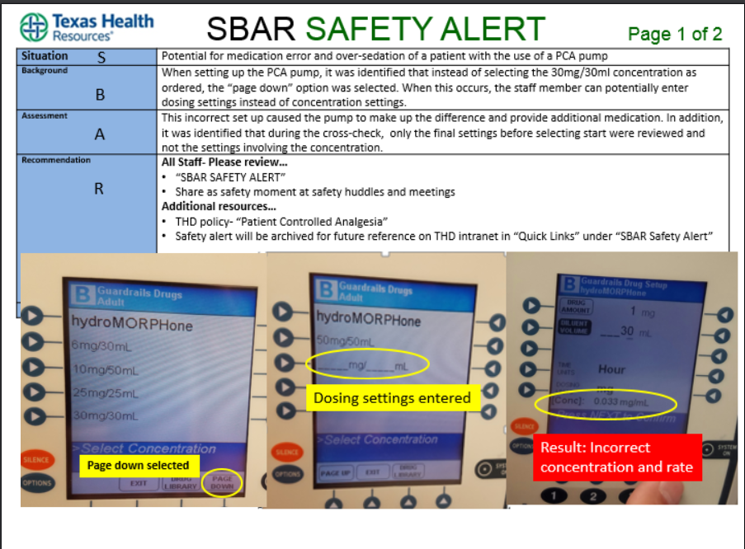
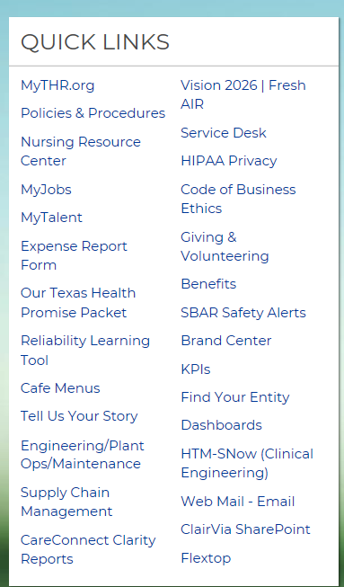
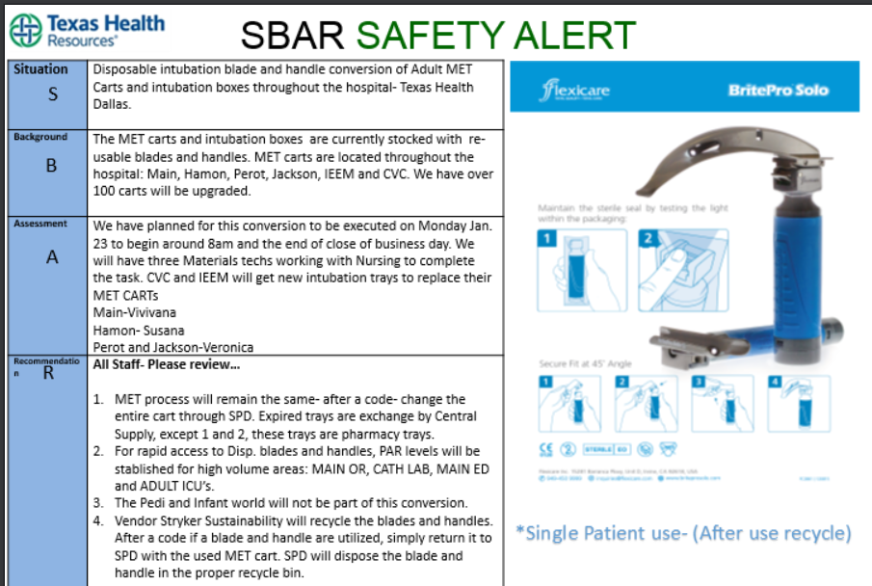
SBAR Safety Alert

Slide 23
200% Accountability
“The world is not a dangerous place because of those who do harm, but because of those who look on and do nothing.” -Albert Einstein
Notes:
Speaker’s Notes:
Ask: What does this quote mean to you?
If you witness any unsafe behavior or action and don’t intervene, you are just as accountable for the outcome as the individual who acted.
We are all responsible for patient safety and prevention of harm.
4 eyes are better than two
The power of peer check- multiplies our reliability
Rhetorical question: If we place our patients and each other at risk by doing nothing, what does it mean to do SOMETHING?
You are what it means to do SOMETHING. And we’ll learn exactly how you’re going to do that. First, let’s think a little more about your role as a coach and the influence you have on the organization.

Slide 24
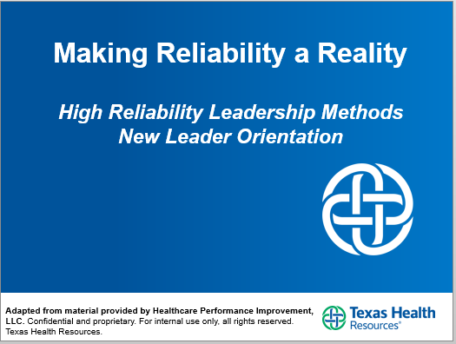
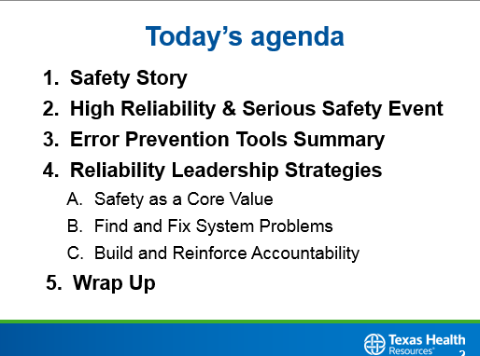
New Leader Orientation
Facilitated by Senior Leader from Entity and THR
All New Leaders are required to attend 2 hour HRO Leader Training (Plus, HRO concepts in New Employee Orientation)

Slide 25
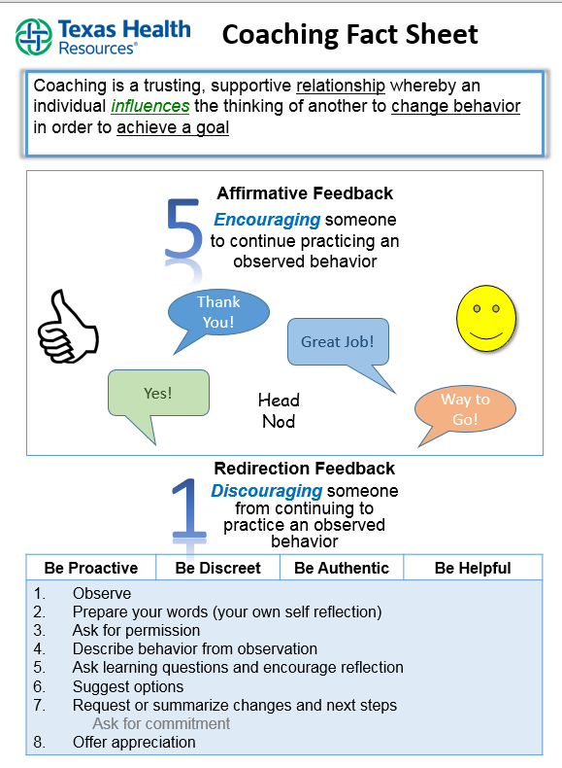
Program Objectives
Reliability Coach Program: Coaching to Zero
Understand the structure of the Reliability Coach program
Articulate/Describe how Error Prevention Tools are most effectively used to decrease harm in the workplace
Develop a comfort level performing peer coaching and understanding of ongoing activities
Link peer coaching techniques with affirmative and redirection coaching with Our Texas Health PromiseSM Behaviors
Demonstrate coaching techniques through skill building with affirmative and redirection coaching
Understand expectations for communicating and documenting coach interactions
Notes:
Understand the structure of the Reliability Coach program
Articulate/Describe how Error Prevention Tools are most effectively used to decrease harm in the workplace
Develop a comfort level performing peer coaching and understanding of ongoing activities
Link peer coaching techniques with affirmative and redirection coaching with Our Texas Health PromiseSM Behaviors
Demonstrate coaching techniques through skill building with affirmative and redirection coaching
Understand expectations for communicating and documenting coach interactions

Slide 26
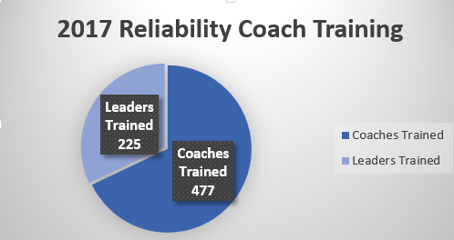
Reliability Coach Training
2017 Training
7/11- 9/14/2017
24 Training Sessions supported by THR Patient Safety
2 Training sessions for JVs supported by HPI
2018 Sustainment
Quarterly System Services Facilitated Training
1/2018 Train the Trainer for Entity Coach Facilitators
Onsite Entity training for => 15 participants
Monthly Reliability Coach Facilitator Meetings

Slide 27
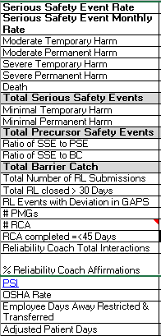
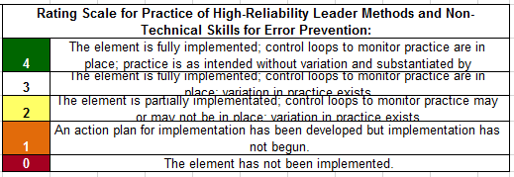
Pulling it all together: Development of RISI
(Reliability Implementation & Sustainability Index^{SM)}
HPI Index measure
Outcome Metrics
Reliability & Safety Transformation Metrics
Effectiveness Assessment of High Reliability Behaviors
Organizational Climate Assessment
Notes:
RISI is a HPI methodology for capturing a full menu of patient safety measures for a more comprehensive view of our high reliability journey.

Slide 28
Governance Evolution and HRO Development

Slide 29
Recent Governance Developments at THR and HRO Impact
System Governance was not an early adopter…they were a First Adopter
Governance now centralized at the THR System Board through “mirror boards” at the entity level for the Wholly Owned Hospitals
Delegation of credentialing and privileging to the System Quality and Performance Committee (QPC) along with Quality and Patient Safety Reporting
Ongoing refinement of the Quality and Patient Safety Report to Governance

Slide 30
THR Governance Retreat and HRO Implications

Slide 31
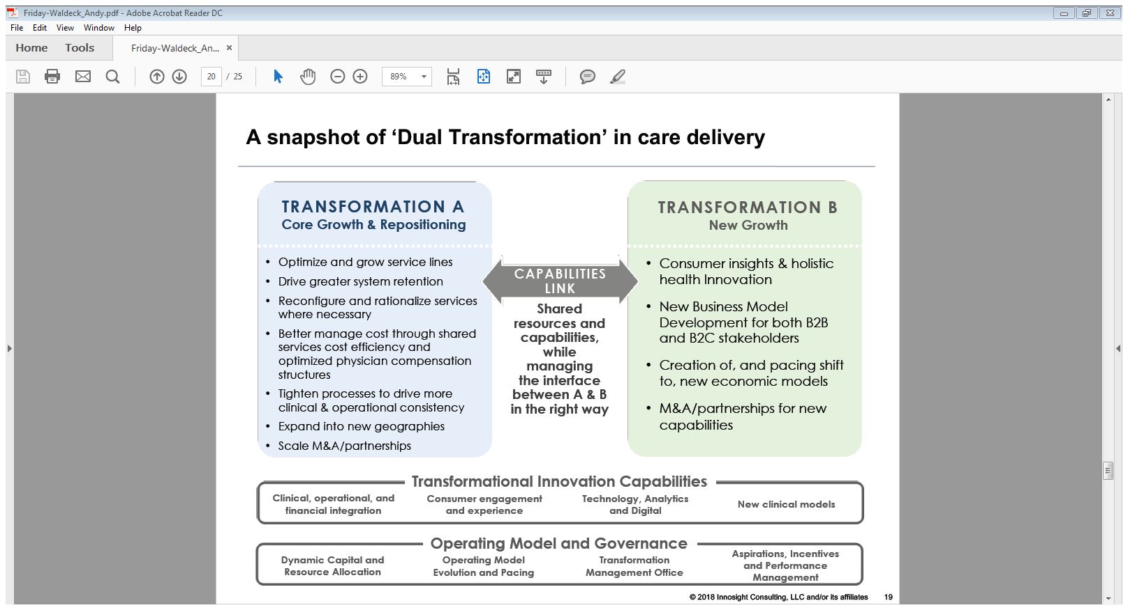
HRO Evolution and Dual Transformation

Slide 32
HRO Evolution and Dual Transformation
HRO principles are clearly critical to the “Transformation A” portfolio of work, particularly relative to clinical and operational consistency of existing services and any emerging clinical service line development
Are clearly key Capabilities to be used in both “Transformation A” and “Transformation B”
Vital to addressing the “New Normals,” at least the first four

Slide 33
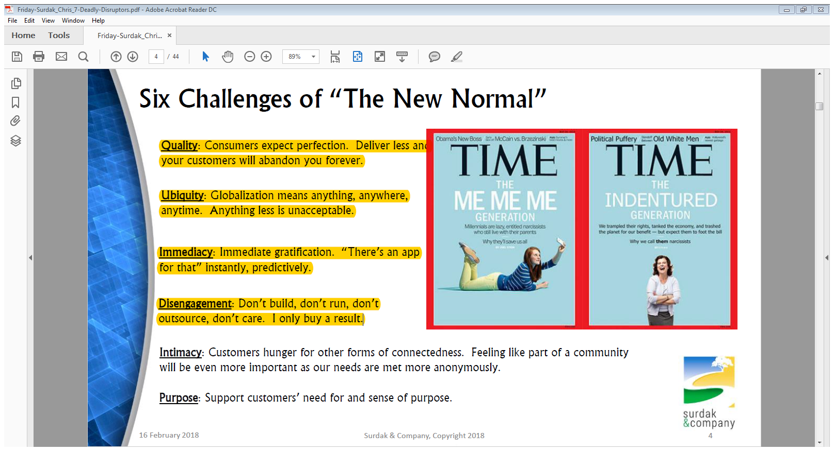
HRO Development and “Jerk” Disruption

Slide 34
Lessons Learned at THR on our HRO Journey

Slide 35
Lessons Learned So Far at THR
We have been very successful at training/deploying/reinforcing HRO principles
We have been very successful at adopting a framework for accountability at the Governance and Management levels and reinforcing that framework
We have been moderately successful at hardwiring HRO principles and extending them to other portfolios of work (e.g., Reliable Care Blueprinting) at the design level

Slide 36
Lessons Learned So Far at THR
We have been much less successful at post-deployment execution and compliance than we would have liked
We still have a long way to go to create a culture of transparency and accountability
  Still issues regarding reporting
    Fear of punishment
    Fear of looking bad
    Fear that it won’t make a difference
    Concerns that the process and tool still are barriers to use
  Concerns regarding professional peer review

Slide 37
Lessons Learned So Far at THR
Obsession with Outcomes is still a work in progress
  Still getting wrapped around the axle too often on Process
  Still dealing with Kubler-Ross issues on data and analytics
  “Perfect is the enemy of the Good” still in play
Governance change is advancing the conversation on clinical performance and accountability management
  Will eventually be a driver for enhanced standardization system-wide
Extending HRO principles across the continuum and into partnerships is still desired, but is still a work in progress

Slide 38
Lessons Learned So Far at THR
Making sure that our transformational agenda successfully and efficiently incorporates these principles is not so much a question of intent and will, but more a question of how?
We would still recommend the journey strongly…it is the right thing to do

Slide 39
Question & Answer
Notes:
Biggest Challenge
Biggest Win
Leadership Engagement
Sustainment Efforts
Sharp End vs. Blunt End

