Slide 1
A Blueprint for a Systemwide, Profitable Behavioral Health Service Line
Michael Clark, M.D. Chairman Psychiatry
John Deeken, M.D. COO Translational Medicine
Loring Flint, M.D. EVP & CMO
Michelle Mullany, AVP Behavioral Health
Inova Health System, Falls Church, VA

Slide 2
Behavioral Health: Planning and Implementing a Profitable Service Line

Slide 3
Overview of Inova Behavioral Health
Full continuum of Behavioral Health services
  87 adult psychiatric inpatient beds
  2 PHP (ADC of 20)
  5 outpatient clinics (med management and therapy)
  Child and Adolescent Services
  Substance Abuse services
    Inpatient detoxification
    Day Treatment
    Intensive Outpatient Program
    Medication Assisted Therapy
    Relapse Prevention
  Psychiatric Assessment Center and Urgent Care

Slide 4
Problem: Unsustainable Model of Psychiatric Care
2016 - Needed a new paradigm
World class, destination hospital
  Poor access to BH services, low productivity and high costs
  System of care lacked organization, patient experience not optimized
Siloed service line, lacked integration with other disciplines
Model of care that focused on use of MDs with little support staff
Incurred annual loss of $300k
Dilemma
How do we preserve and continue our mission and eventually expand on it?
300% increase in monthly costs per patient when behavioral health co-morbiditites are involved (SAMHSA)
Solution
We needed to change the model

Slide 5
Challenges in Behavioral Health Reimbursement
Inpatient reimbursement rates are disproportionately high compared to outpatient rates → incentive toward hospitalization
Pre-authorization is lengthy and cumbersome → costly to manage closely
Stagnant insurance reimbursement and burdensome rates ensure services stay cash-only endeavors
Burdensome documentation requirements
Psychiatric workforce declines by 10% every 10 years
Hospitals negotiate lower rates for BH or do not include at all → disincentivized care
Poor reimbursement creates barriers to recruitment and retention
Many hospital systems faced with decision to discontinue psychiatry services

Slide 6
Areas of Focus
Analyzed business
Determined costs and identified growth opportunities
Designed and executed plan
Evaluated outcomes
Established goals for break even
Areas of Focus
Access/Integration
Cash Collections
Efficiency
Investment - Evaluation of distressed assets, balance with value to community

Slide 7
Access to Care
Goal: provide timely care and create a referral system into any part of BH without complications
Create access at any point in the system
  Centralized Call Center co-located with clinical staff for quick referral
  Risk stratification on phone triage for appropriate provider level
      40% of callers did not require a psychiatrist for medication
  Decrease high reliance on psychiatrists → long wait times
Improve Staff Mix
  Shift from 5:1 ratio of outpatient MD to therapists
    Reduced costs, allowed MDs to work to the top of license
    Investment support staff such as Care Navigators, Medical Assistants, and LPNs was critical to improved productivity
Psychiatric social workers on medical units
Bridge Program

Slide 8
Collections
Goal: optimize front end cash collections
Significant investment in up-front insurance verification process
Investment in internal denials management
  Denials decreased 50% in 1st quarter
  Reduced AR by 84% in 6 months
Created policies on missed appointments and co-pay expectations
Implemented reward based system for collections
Overall improvement in collection rate--> 23% - 94%
Patient satisfaction and staff engagement improved

Slide 9
Efficiency
Goal: Improve efficiency of providers
Created block scheduling of patient appointments to reduce no-show rates
Implemented flexible provider schedules to manage costs
Partnership with graduate schools
  Creates pipeline, decrease training time/costs
Determine best use of APP
Integration with Primary Care
  Good payer mix
  Unique patient needs determined model of LCSW and Psychologists
  Payment to primary care to offset costs, set expectations for collections and scheduling
  Education series to primary care MDs, ongoing telephonic consultation

Slide 10
Child and Adolescent Care
Goal: provide comprehensive care, expand services
Focus on recruitment
  Strategic decision to pay higher salaries
  Quality of life in scheduling
Focus on strategic location of services to minimize costs
Concentrated efforts on front end work
School acquisition
  Revenue streams
  Allows for psychiatric treatment within educational environment

Slide 11
Outcomes
$6 million net profit in 2017
Increased overall service line capacity by 62%
Decreased inpatient admissions by 17%
Increased outpatient care by 23%
Therapists have highest productivity of all providers
    Better coordination of care, less MD follow up appts needed
    Reduction in appointment wait times from 4 months to same week

Slide 12
Lessons Learned
Once access was created, containment and productivity were easier
  Fluid transitions between programs
  Highlighted value of psychiatry within hospital system
Technology creates ease-of-access through telemedicine, yeyt reimbursement/parity remain barriers to implementation
Easy to lose focus on prioirities
Find the right talent
  Switched hiring practices from skills → attitude and mission orientation
  Evolve hiring practices in the light of specialty shortage
  Invested in onboarding of MDs, culture of collegiality
Appointment scheduling is more critical than expected due to shortage of providers
Referral of patients to appropriate level of care is important to better outcomes
A system of care is required to maintain a sustainable model of care

Slide 13
Next Steps
Break Even targets
Critical decisions about managed care contracts
  Creative contracting - Managed Care vs. PMPM
  Proactive management of denials
  Weave behavioral health into the fabric through all levels of the organization
    Behavioral Health First Aid implementation throughout system
    Enhanced focus on integrated specialty services OB/GYN, Addiction Medicine, Neurosciences
    SBIRT as standard practice
    Use of peers in discharge planning and follow-up
Comprehensive child and adolescent model
    School partnerships
    ED diversion and coordination with municipalities

Slide 14
Questions
Final Thoughts

Slide 15
The prevalence of mental illness
50% of the general population reported at least one lifetime disorder
  1.1% of adults in the U.S. live with schizophrenia
  2.6% of adults in the U.S. live with bipolar disorder
30% reported at least one 12-month disorder
  6.9% of adults in the U.S. had at least one major depressive episode in the past year
  10% of the population uses illicit drugs, 25% of the population uses tobacco products
More than half of all lifetime disorders occurred in the 14% of the population who had a history of three or more comorbid disorders and included the majority of people with severe disorders
Less than 40% of those with a lifetime disorder had ever received professional treatment, and less than 20% of those with a recent disorder had been in treatment during the past 12 months
18.1% of adults in the U.S. experienced an anxiety disorder such as posttraumatic stress disorder, obsessive-compulsive disorder and specific phobias
Among the 20.2 million adults in the U.S. who experienced a substance use disorder, 50.5%—10.2 million adults—had a co-occurring mental illness

Slide 16
The products of inadequate treatment
Serious mental illness costs America $193.2 billion in lost earnings per year
Mood disorders, including major depression, dysthymic disorder and bipolar disorder, are the third most common cause of hospitalization in the U.S. for both youth and adults aged 18–44
Individuals living with serious mental illness face an increased risk of having chronic medical conditions. Adults in the U.S. living with serious mental illness die on average 25 years earlier than others, largely due to treatable medical conditions
Over one-third (37%) of students with a mental health condition age 14­–21 and older who are served by special education drop out—the highest dropout rate of any disability group
Suicide is the 10th leading cause of death in the U.S.
  3rd leading cause of death for people aged 10–14
  2nd leading cause of death for people aged 15–24
  More than 90% of children who die by suicide have a mental health condition
  Each day an estimated 18-22 veterans die by suicide

Slide 17
The promises of genetics
Cause and effect explanations
Ability to find and define broken parts
Develop new “cures”

Slide 18
The potentials of pharmacogenomics
Precision medicine
Optimize response rates
Minimize adverse events
Decrease time to remission
Avoid unnecessary risks of ineffective therapies
Reduce costs for high utilizers of health care

Slide 19
The problems of psychiatry
Disorders beyond diseases
Neurobiological contributions are difficult to define
Extensive searches of the genome have low yields
Few defined “genotypes”

Slide 20
The pragmatics of progress in psychiatry
Relevant genetic variations exist for psychiatric disorders
Specific genetic variations are disproportionately present
Naturalistic variations in treatment selection correlate with discoveries in genetic variations
Guided decision-making produces better outcomes longitudinally

Slide 21
The perils of pharmacogenomics testing
Theoretical
  History could repeat itself
  Drug tolerance and efficacy represent highly complex traits
  Influenced by numerous genetic variants in multiple combinations of genes acting with even less definable environmental factors
  Genetic determinants have modest effects
Practical
  Phenotypes are heterogeneous
  Clinical samples have high rates of comorbidity and multimodality treatments
  Clinical samples composed of a mixture of genetic influences
  Pharmacology is incomplete (MOA, metabolism)
  Efficacy assumes compliance and noncompliance confounds study

Slide 22
The premises for pharmacogenomics testing
Mental illness prevalence is approximately 50% of hospital admissions frequently precipitating the admission and contributing to the failure of discharge plans resulting in readmissions
Mental illness diagnoses are less likely to be recognized by healthcare professionals and when recognized, they are more likely to be coded as a secondary diagnosis, which minimizes their impact on outcome
Mental illness consequences negatively impact every healthcare outcome including response to medical/surgical treatment, complication rates, costs, and satisfaction of both patients and providers
Mental illness stigma perpetuates barriers to engaging patients in treatment, achieving recovery and returning to productive lives
Mental illness healthcare is the source of hope for beginning, executing, and sustaining tailored, effective treatment strategies
How can we continue to expect someone else to help our patients?

Slide 23
The practicalities of pharmacogenomics testing
Questions
  When would I order the test?
  How do I interpret the results?
  What do I do with the information?
Answers
  If the patient has a refractory condition and high healthcare costs
  As collateral information that functions as a guide, not an absolute
  Look for patterns that link the patient’s experiences to the test results

Slide 24



Your genes. Your roadmap.™
Overview
Overview of Pharmacogenomics (PGx)
Implementation in a Health System
Discussion

Slide 25
Why Pharmacogenomics?
All patients with same diagnosis
Non-Responders and Patients Experiencing Severe Toxicity
Responders and Patients not Experiencing Severe Toxicity

Slide 26
Pharmacologic Variability:
Genetics play an important role in drug metabolism
Morphometric
Drug specific
Body size
Body composition
Dose and schedule
Variability
Demographic
Genetics
Age
Race / ethnicity
Sex
Drug metabolism
Drug transporters
Physiologic
Environment
Disease
Hepatic function
Renal function
Interactions
Drug-drug
Drug-CAM
Drug-formulation
Drug-food constituent
Deeken J et al Anti-Cancer Drugs 2007

Slide 27



Goal of Precision Medicine and Pharmacogenomics (“PGx”)
Right Drug
Right Dose
Right Patient

Slide 28





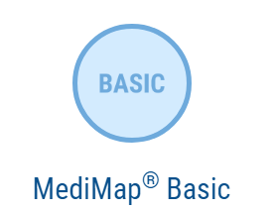


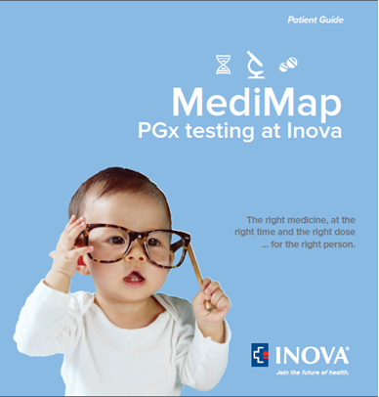
Condition Specific
Baseline Testing
Inova.org/YourRoadmap

Slide 29


®
    The MediMap® Mind
    test is designed to provide information to more effectively manage mental health.
    The MediMap® ADHD test is designed to provide information to more effectively manage a child’s ADHD.
Price (self-pay): $295
# of genes tested: 14
# of associated drugs: 62
Method: Cheek Swab
Price (self-pay): $195
# of genes tested: 3
# of associated drugs: 7
Method: Cheek Swab

Slide 30

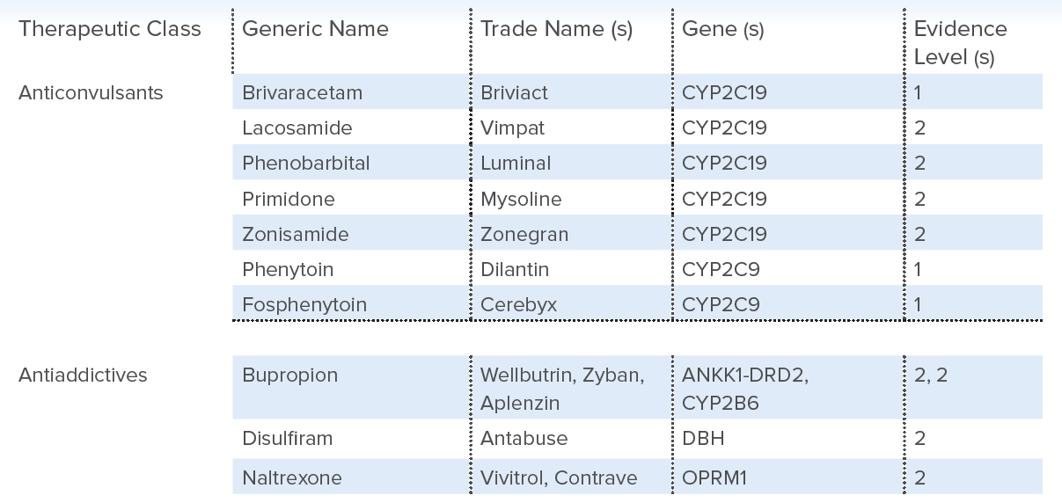
Gene/Drug List Example: 62 Drugs | 14 Genes

Slide 31

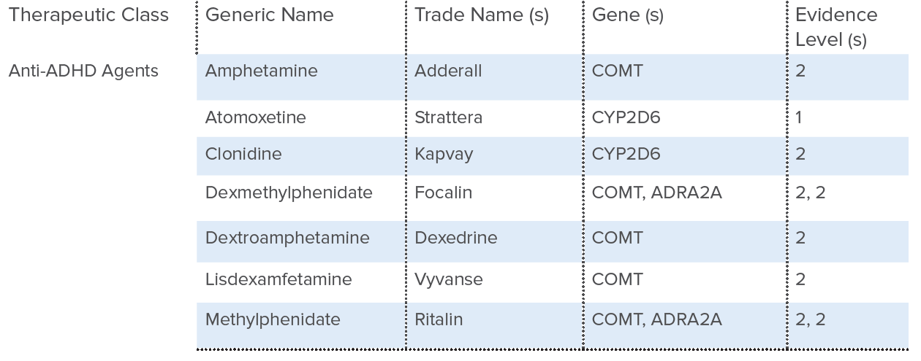
Gene/Drug List Example: 7 Drugs | 3 Genes

Slide 32
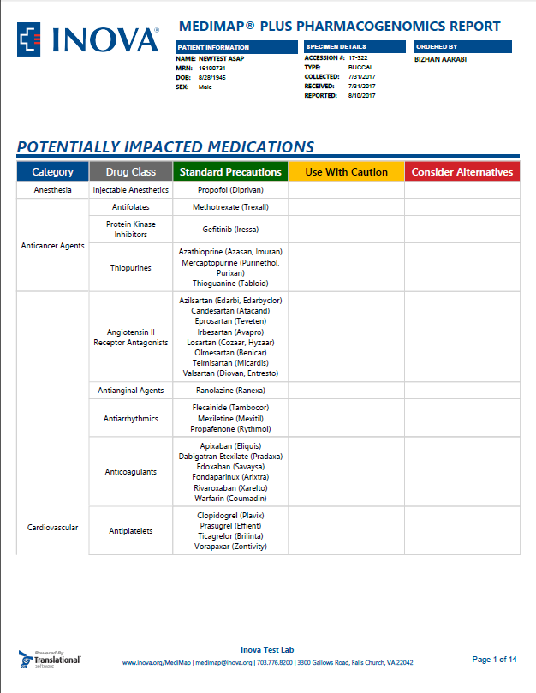


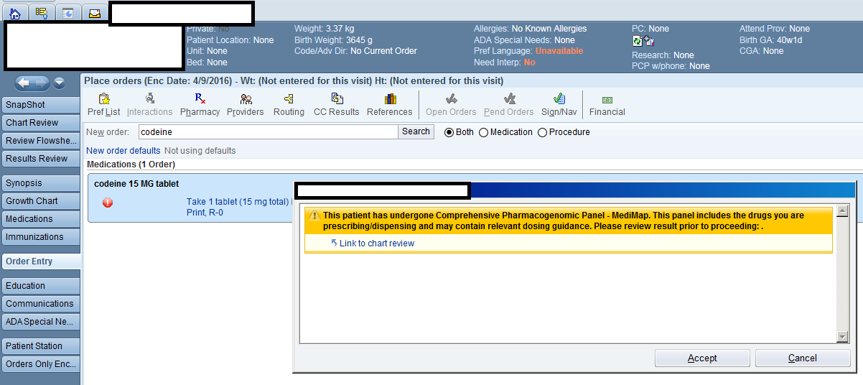
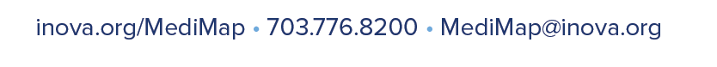
EHR & BPAs
Results populate EHR
Reports to patients and physicians
Expert “back-up”

Slide 33
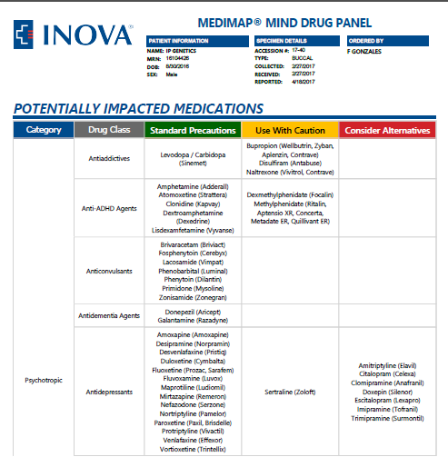
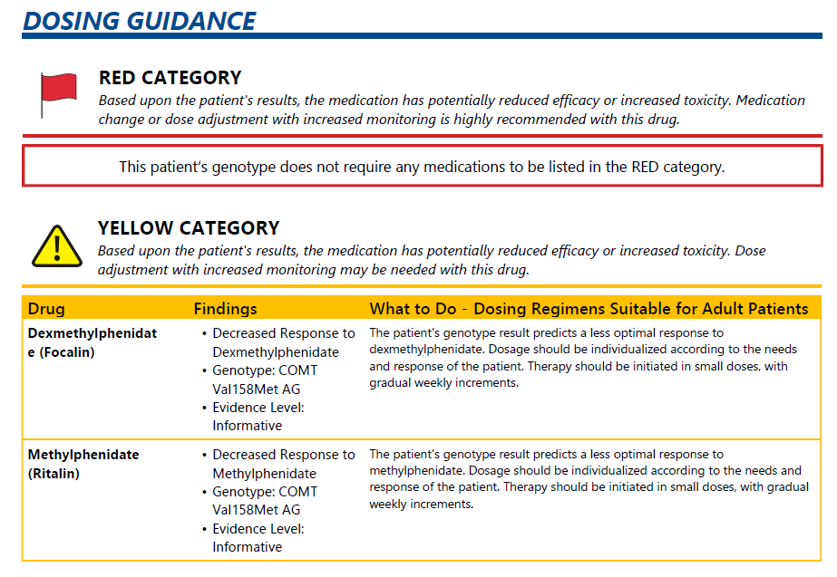
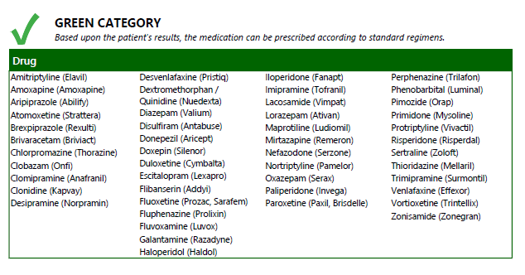
MediMap® Sample Report & Dosing Guidance

Slide 34
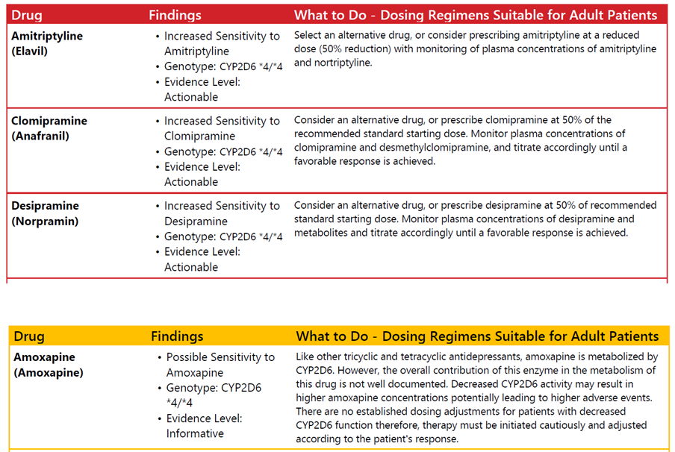
Evidence Levels (Actionable vs. Informative)

Slide 35







All of our results are based on the highest level of evidence provided by PGx Review Bodies
Evidence Level 1 | Actionable | ESTABLISHED EVIDENCE-BASED CLINICAL GUIDELINES
Evidence Level 2 | Informative | DRUG-GENE ASSOCIATIONS REQUIRING FURTHER INVESTIGATION

Slide 36
Your genes. Your roadmap.™
Overview
Overview of Pharmacogenomics (PGx)
Implementation in a Health System
Discussion

Slide 37

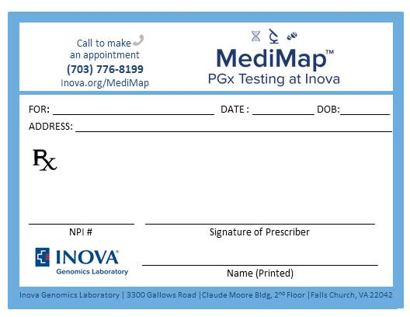
Physicians & Ordering Options for MediMap®
1
2
3
Inova Genomics Laboratory physicians place order in Epic
Inova physician places order in Epic
Physician writes MediMap® prescription
EPIC
EPIC
Patient appointment at IGL
Patient appointment at IGL
Patient appointment at IGL
IGL physician will receive Epic notification to view PDF results.
Ordering physician will receive Epic notification to view PDF results.
Physician NPI is used to place order in Epic. Prescription is scanned into Epic.
MediMap® results are mailed to patient.
MediMap® results are mailed to patient.
MediMap® results are mailed to patient and ordering physician

Slide 38









MediMap® Clinic Process Overview
Make an Appointment
Access to a genetic counselor
1
2
3
Complete
Authorization
& other forms
Receive MediMap®
test results
Inova Genomics
Laboratory
processes
sample
6
5
4
Get
swabbed
EPIC
mail
7
Share results
with physician.
8
Ask our genetic counselors

Slide 39

Genomic Data Safety
DATA
USE
IRB
DATA
SHARE
GCP
Q/C
FEEDBACK
Transparent
Use
Privacy
Protection
Safe Storage
HIPAA
CLOUD
GINA
INOVA IT
HITECH
FIREWALL
Notes:
Talking points:
Privacy Protection:
Genomic data (like any other health data) communicated in compliance with HIPAA regulation
- Patients are protected by the genetic non-discrimination act GINA (for example: their genetic info will never be shared with their employer, even if the employer provides PGx as a benefit)
- We follow The Health Information Technology for Economic and Clinical Health (HITECH) Act, HITECH promotes the adoption and meaningful use of health information technology. Specifically D of the HITECH Act addresses the privacy and security concerns associated with the electronic transmission of health information, in part, through several provisions that strengthen the civil and criminal enforcement of the HIPAA rules.
Safe Storage
- EMR (Epic) where clinical genomic records are hosted for care team view are meeting Inova IT’s standards of data safety and security.
- All patient records (genomics) are stored and exchanged behind the firewall for protection from unauthorized access.
This firewall provides secure environment for exchange of sensitive health data with third parties evolved (Transoft).
- Inova sets industry-wide standards of big data (genomics) management via utility of secure Cloud environment and local servers -> in high efficiency and usability of large amounts of generated data.
Transparent Use
- At Inova all steps of genomic data generation and analysis are highly regulated by our standards of quality control. In both environments: research and clinical genomic data
curated by specific rules and regulations:
1) Good Clinical Practice (GCP) is an international ethical and scientific quality standard for the design, conduct, performance, monitoring, auditing,
recording, analyses and reporting of clinical trials. It also serves to protect the rights, integrity and confidentiality of trial subjects.
2) Under FDA regulations, an IRB is an appropriately constituted group that has been formally designated to review and monitor biomedical research involving human subjects.
In accordance with FDA regulations, an IRB has the authority to approve, require modifications in (to secure approval), or disapprove research.
Patient Empowerment
- Patient empowerment and engagement in the decisions regarding use of his/her genomic data is one of the priorities at Inova.
- Tiered questions are imbedded in research consent documents and genomic testing authorization forms to give patients control over destiny of their samples and data use
(to allow further data share or not).
- Patient’s feedback is considered in the revisions of the research informed consent documents and clinical auth. forms.
- Genomic Data use is carefully discussed with multidisciplinary group of scientists, ethicists, legal counsel (internal and external) and any other pertinent parties
to assure foreseen and unforeseen risk mitigation associated with genomic data use.

Slide 40

The Genetic Information Nondiscrimination Act of 2008 (Approved May 21, 2008)
To prohibit discrimination on the basis of genetic information with respect to health insurance and employment.
*Note: Currently excludes life insurance, disability insurance, and long-term care insurance.
Factors to consider for Inova:
Inova is a health system / provider…
…rendering services to patients who are also employed by Inova.
Inova is a self-insured employer…
…offering health plan choices to its employees and their dependents (incl. access to a wellness program).
Inova has an in-house CAP-accredited and CLIA-certified genomics laboratory (IGL)…
…providing genetic testing services to patients (who could also be Inova employees).

Slide 41


How to get MediMap
Interested to learn more about MediMap® testing?
Would like to schedule an appointment?
(doctor’s referral not required)
We want to hear from you!
MediMap@inova.org
703.776.8200
inova.org/MediMap

Slide 42
Your genes. Your roadmap.™
Overview
Overview of Pharmacogenomics (PGx)
Implementation in a Health System
Discussion

